Slide 1
Fine-tuning LLMs for SQL Query Generation: Mistral vs Llama 3.1
INFO7610 Natural Language Engineering Methods/Tools
Princy Patel 002319488

Slide 2
Introduction
Project Overview: Fine-tuning large language models to enhance SQL query generation capabilities
Models used: Mistral 7B and Meta Llama 3.1 8B
Purpose: Improve SQL generation capabilities using the same dataset
Approach: Parameter-efficient fine-tuning using the Unsloth framework for cost-effective training

Slide 3
About the Dataset
Dataset: gretelai/synthetic_text_to_sql
Size: 100,000 training examples, 5,851 test examples
Key fields:
sql_prompt: Natural language query
sql_context: Database schema definition
sql: The actual SQL query
sql_explanation: Explanation of how the query works
Features: Various domains, complexity levels, and SQL task types

Slide 4
About Unsloth AI
What is Unsloth? Open-source optimization framework designed specifically for efficient LLM fine-tuning
Core Technology:
Flash Attention 2 for optimized attention computation
Quantization techniques (4-bit precision) to reduce memory requirements
Smart gradient checkpointing to balance speed and memory usage
VRAM offloading strategies for consumer GPU compatibility
Performance Benefits:
2-3x faster training compared to standard implementations
70% lower memory requirements enabling training on consumer GPUs
Support for longer context windows without memory explosion
Specialized Features:
Built-in chat template handling for various model architectures
Response-only fine-tuning capability to focus learning on outputs
Automatic handling of tokenization edge cases
Progressive batch size determination for optimal GPU utilization

Slide 5
Models Used
Mistral 7B:
7 billion parameters
4-bit quantization (BNB)
Efficient for smaller GPUs
Vocabulary size- 32k Tokens
Llama 3.1 8B:
8 billion parameters
4-bit quantization (BNB)
Improved context handling
Enhanced instructions following
Vocabulary size- 128K Tokens

Slide 6
Dataset Preparation: Mistral
Conversation Structure:
System prompt: "You are a SQL assistant that helps users write SQL queries..."
User message: Combination of SQL prompt and schema context
Assistant message: SQL query and explanation
Formatting Details:
Custom Mistral chat template with <|system|>, <|user|>, and <|assistant|> tokens
Human/GPT role mapping using {"role": "from", "content": "value"} format
EOS token mapping to ensure proper sequence termination
Implementation Challenges:
Ensuring proper token alignment for training objectives
Handling special tokens consistently across tokenization

Slide 7
Dataset Preparation: Llama 3.1
Specialized Format:
Using Llama 3.1's native chat template with header identifiers
Format: <|begin_of_text|><|start_header_id|>system<|end_header_id|>...<|eot_id|>
Technical Implementation:
System/user/assistant content wrapped in appropriate header tokens
Response-only training to focus model learning on SQL generation
Space tokens for padding in labels
Optimization Techniques:
Using DataCollatorForSeq2Seq for efficient batch construction

Slide 8
Training Configuration & Hyperparameters
Common Training Parameters:
LoRA Configuration:
Rank (r): 16 for effective parameter reduction
Target modules: ["q_proj", "k_proj", "v_proj", "o_proj", "gate_proj", "up_proj", "down_proj"]
Alpha value: 16 (scaling factor for adapters)
Training Dynamics:
Per device batch size: 2 samples
Gradient accumulation steps: 4 (effective batch size of 8)
Maximum training steps: 60 (limited for demonstration)
Warmup steps: 5 for learning rate stabilization
Optimizer: AdamW 8-bit for memory efficiency
Maximum sequence length: 2048 tokens

Slide 9
Results Analysis & Performance Comparison
Loss Convergence Patterns:
Mistral: Started at 1.048, ended at 0.420 (60% reduction)
Llama 3.1: Started at 1.048, ended at 0.531 (49% reduction)
Both models showed similar convergence curves with diminishing returns after ~40 steps
Training Speed:
Mistral: ~7.6 minutes for 60 steps (7.6s per step)
Llama 3.1: ~7.75 minutes for 60 steps (7.75s per step)
Memory Utilization:
Both models effectively utilized 4-bit quantization
Peak memory usage remained below 14GB for both models

Slide 10
Inference Quality Analysis
Sample Query: "What is the average explainability score of creative AI applications in 'Europe' and 'North America'?"
Mistral Output:
Correctly produced: SELECT AVG(explainability_score) FROM creative_ai WHERE region IN ('Europe', 'North America');
Complete explanation with filtering rationale
Llama 3.1 Output:
Identical SQL query with slight variations in explanation phrasing
Added calculation details in explanation
Query Structure Accuracy: Both models correctly used:
AVG() function for aggregation
WHERE IN clause for multi-value filtering
Proper table reference
Qualitative Observations:
Both models maintained proper SQL syntax and formatting
Explanation quality was comprehensive in both cases
Similar response structures reflecting the training data patterns

Slide 11
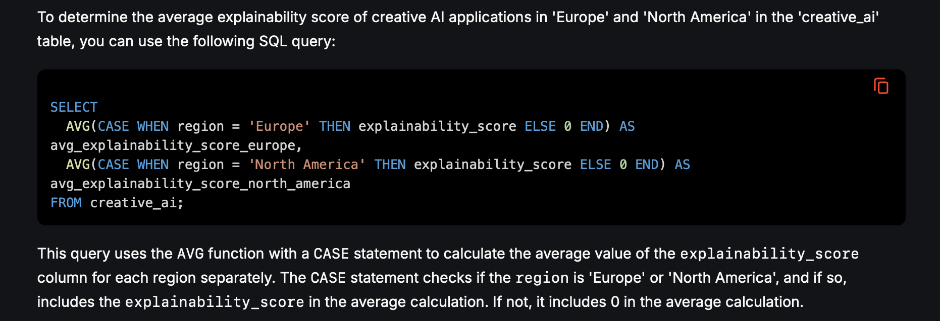
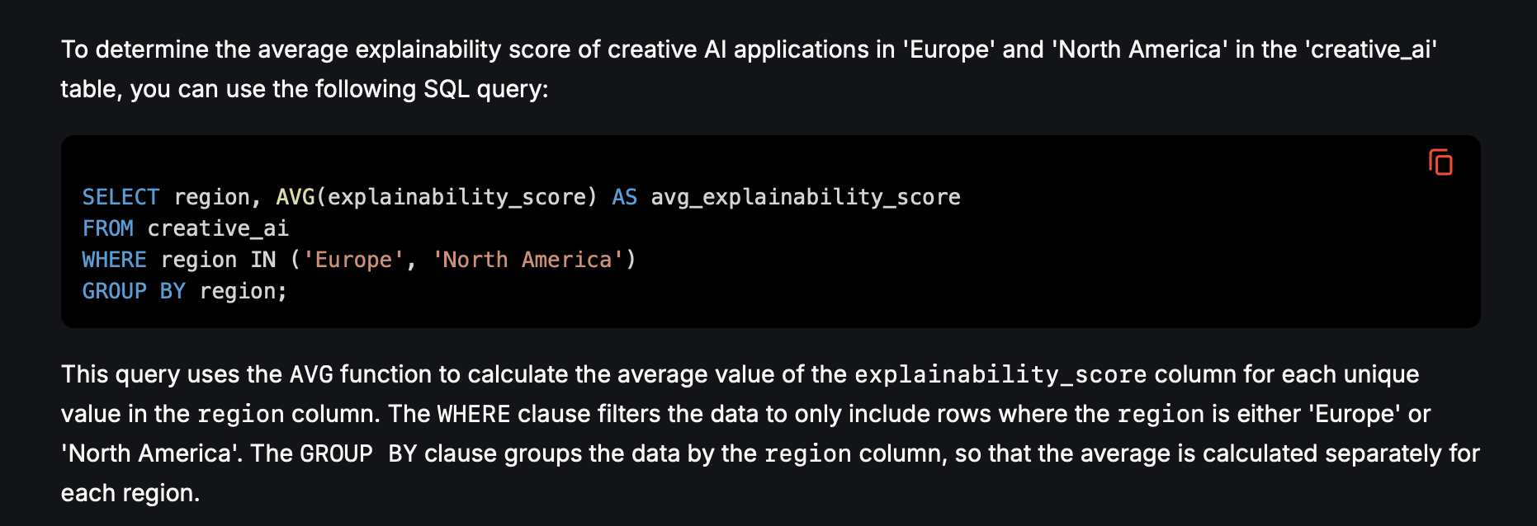
Before Fine Tuning
Llama 3.1 &B
Mistral 7B

Slide 12
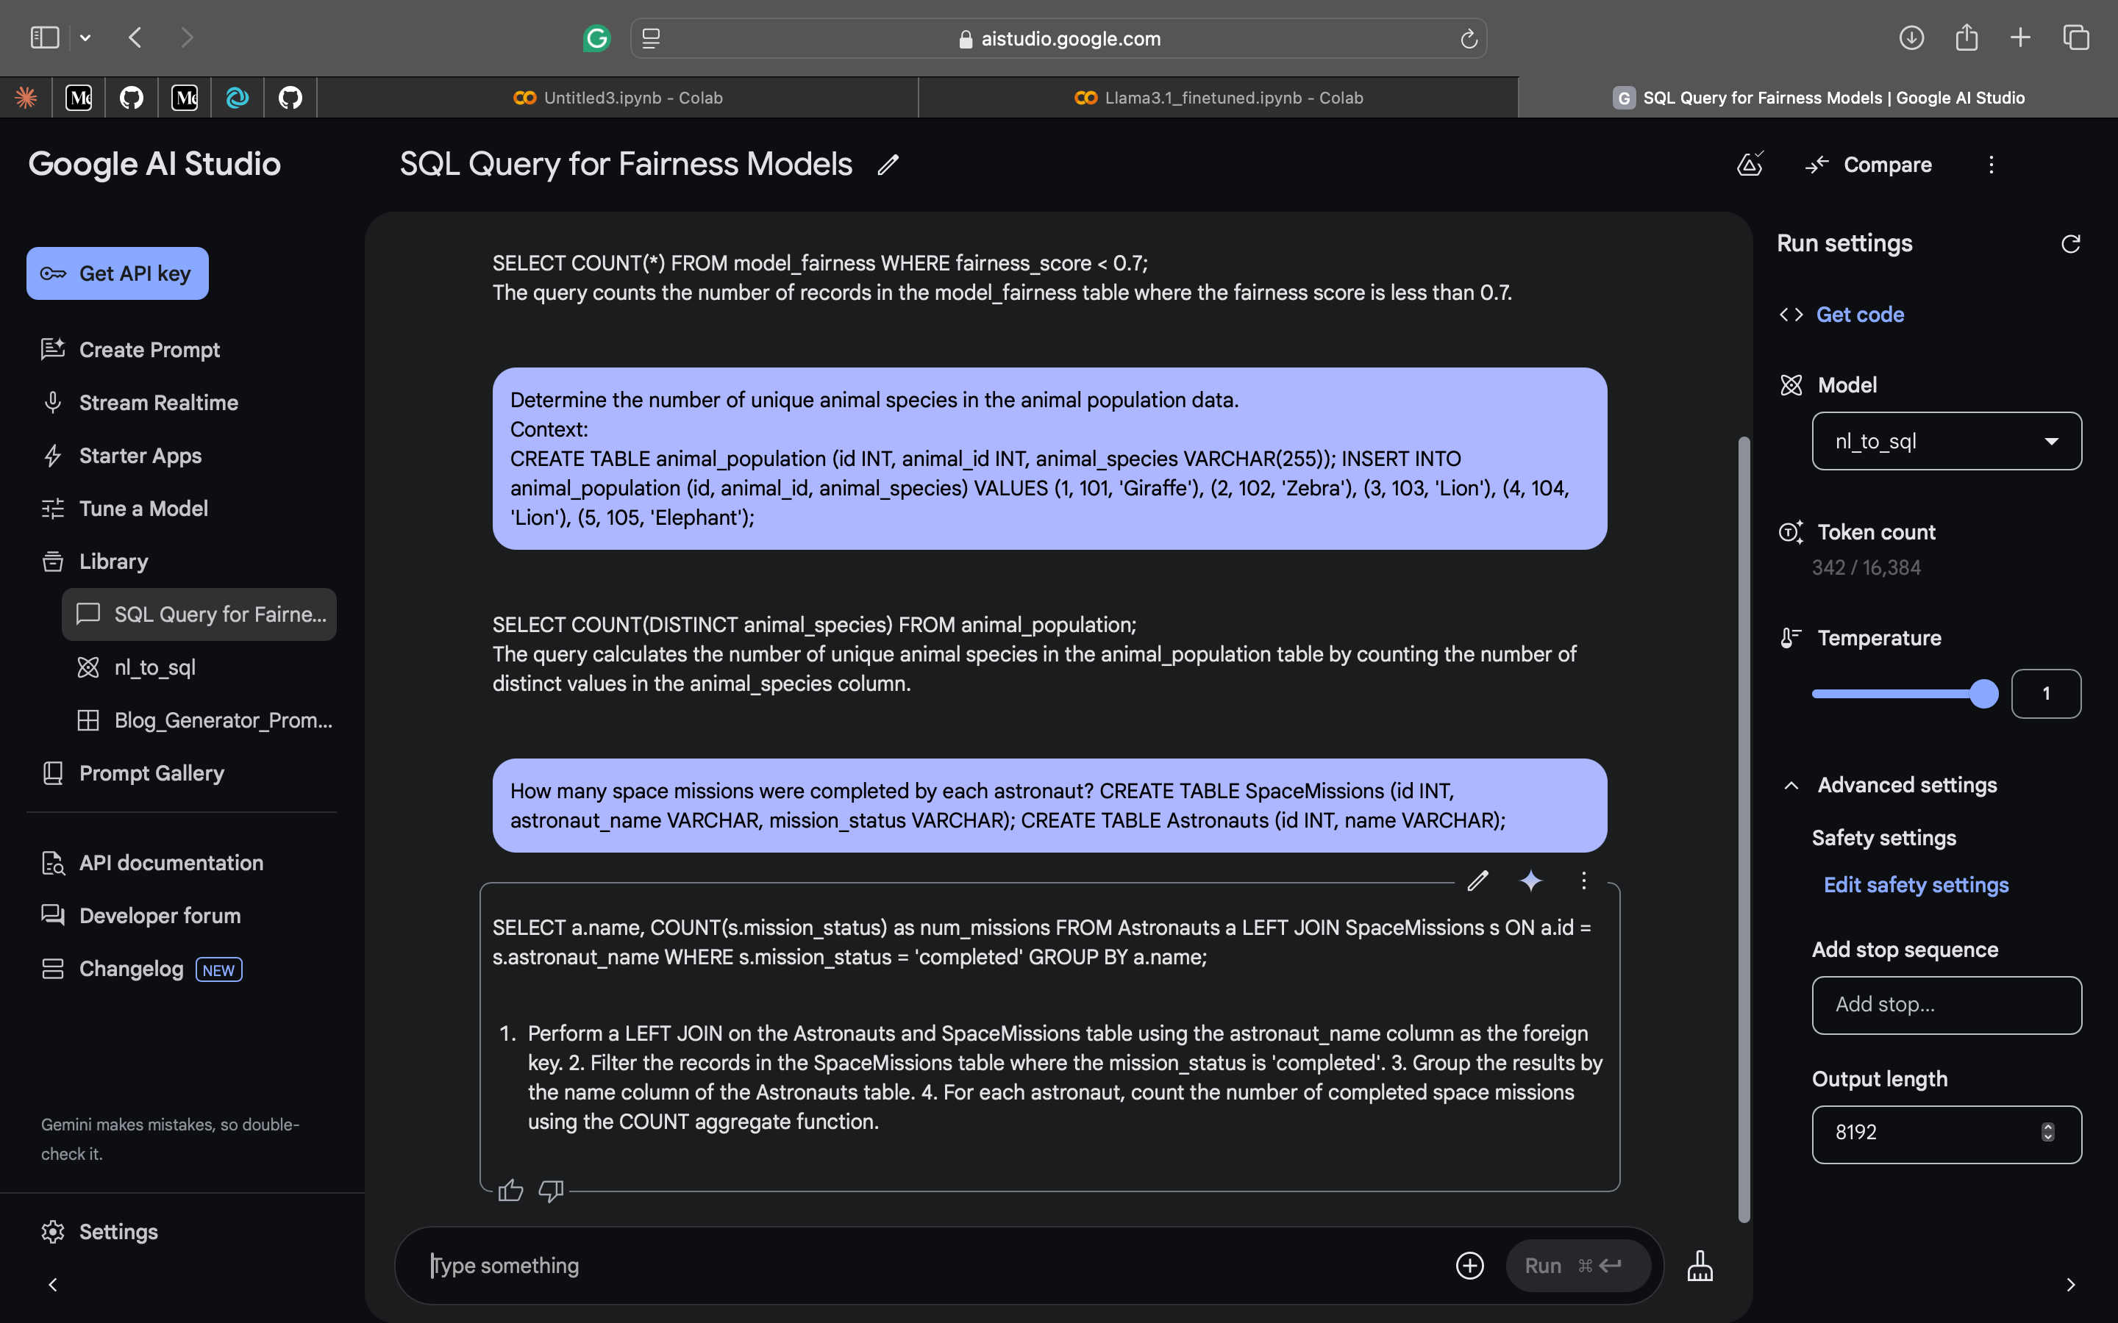
Gemini Fine-Tuned on Google AI Studio

